Slide 1



SQL COURSE FOR BEGINNERS - PART 1
From Database Fundamentals to SQL
Beginner-Friendly
PostgreSQL
Relational Databases
SQL Queries
Database Design
What You’ll Learn
Database Fundamentals
Relational vs. Non-Relational Databases
DBMS & RDBMS
PostgreSQL
Databases & Tables
CRUD Operations
SQL Queries
Table Relationships
Database Schemas

Slide 2
WHAT IS A DATABASE?

Slide 3
WHAT IS A DATABASE (DB)?
Definition
Any organized collection of related information.
Everyday Examples
Smartphone contact list
WhatsApp chat history
To-do list on your phone
Credit card statement
Storage Methods
Physical (notebook, paper)
Mental (memory)
Digital (computer files, cloud storage)

Slide 4
WHY WE NEED DIGITAL DATABASES
High-Volume Systems
Examples: Digital Bank/Fintech
Stores millions of user accounts, balances, and transactions.
Requires 24/7 uptime and instantaneous data access.
Critical data: errors lead to massive financial loss.
High Security: Mandatory protection for sensitive data (tax IDs, passwords, encryption keys).
vs
Personal Notes
Examples: Notepad App
Stores 10 to 50 simple notes.
Casual, local access only.
Convenient, but non-critical data.
Low or no security needed.

Slide 5
WHAT IS A DATABASE MANAGEMENT SYSTEM (DBMS)?
DBMS Definition
Specialized software designed to create, manage, and secure databases.
Core Responsibilities
Security & Access Control
Manages user permissions for reading and editing data.
Backups & Recovery
Prevents data loss during system failures.
Concurrency Control
Allows multiple users to interact with data simultaneously without conflict.
Interface
Connects backend software (Python, Java, Node.js) to the database.

Slide 6


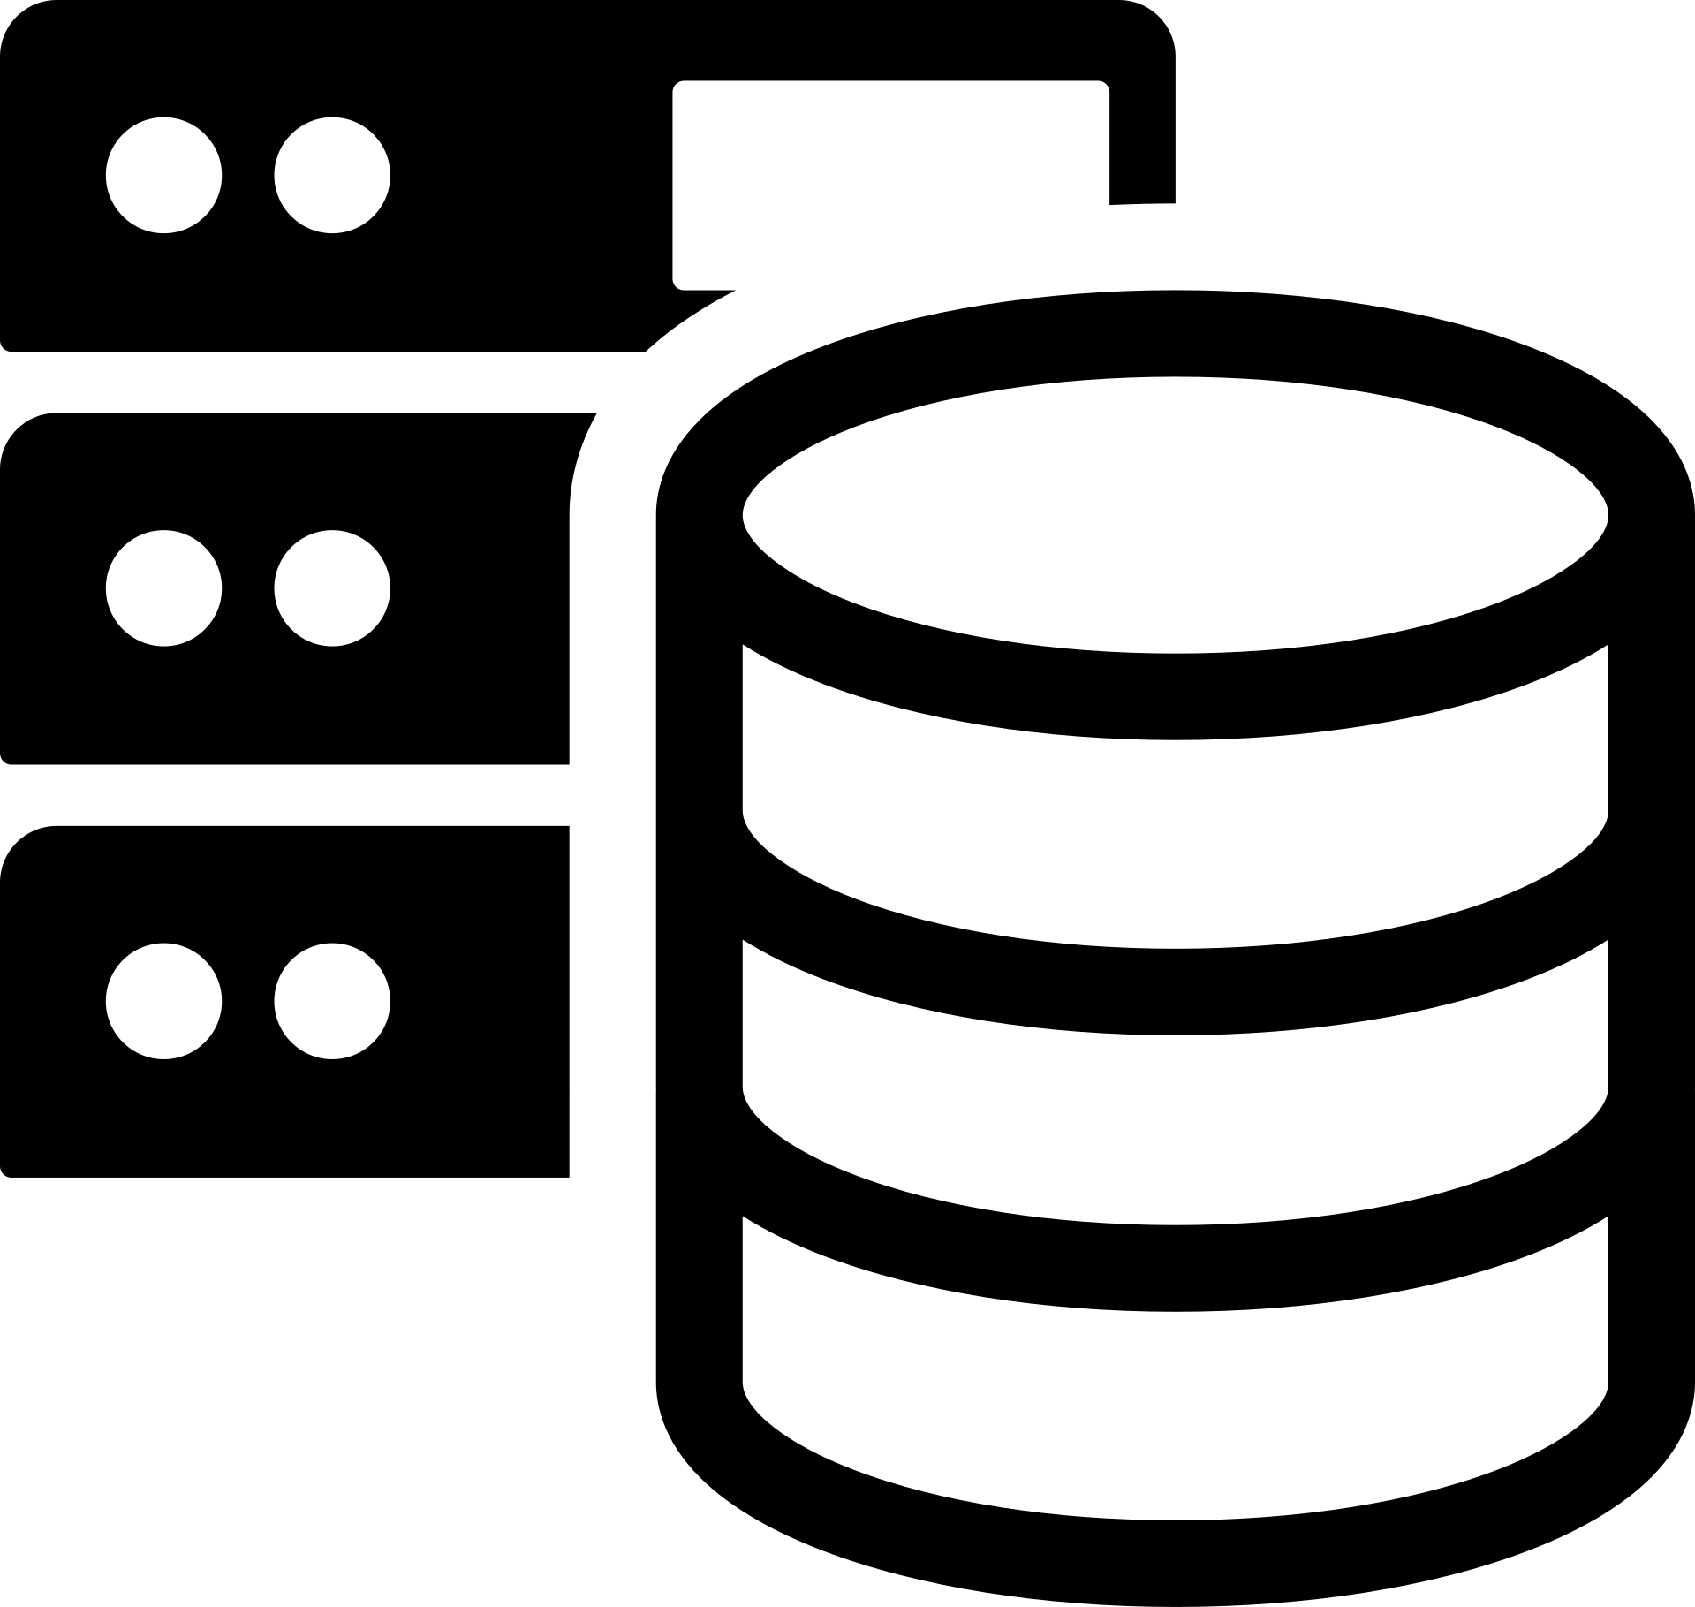

HOW APPLICATIONS INTERACT WITH A DBMS
DBMS Software
Database Storage
Application
The application sends requests to read or modify data.
The DBMS validates security, processes the request, and executes the operation on the storage layer.

Slide 7
C.R.U.D
CREATE
READ
UPDATE
DELETE

Slide 8
TWO TYPES OF DATABASES
Relational Database (SQL)
Organize data into one or more tables
Each table has columns and rows
A unique key identifies each row
Non-Relational Database (noSQL)
Organize data is anything but a traditional table
Key-value store
Documents (JSON, XML, etc)
Graphs
Flexible Tables

Slide 9
RELATIONAL DATABASE (SQL)
Clients Table
Bank Accounts Table
client_id (PK) | full_name | ssn_tax_id
101 | Sarah | 111-222
102 | Marcus | 333-444
103 | Ellen | 555-666
104 | Rippley | 777-888
account_id (PK) | client_id | balance
5001 | 101 | 2500.50
5002 | 102 | 10400.00
5003 | 103 | 150.00
5004 | 104 | 21400.00

Slide 10
THE SQL ECOSYSTEM & RDBMS
RDBMS (Relational Database Management System):
Popular software: PostgreSQL, MySQL, Oracle, SQL Server, MariaDB.
SQL (Structured Query Language):
Standardized language used to communicate with an RDBMS.
Executes CRUD operations, manages permissions, and defines schema structures.

Slide 11
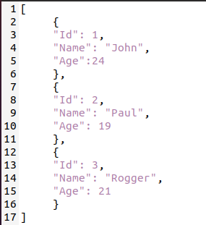
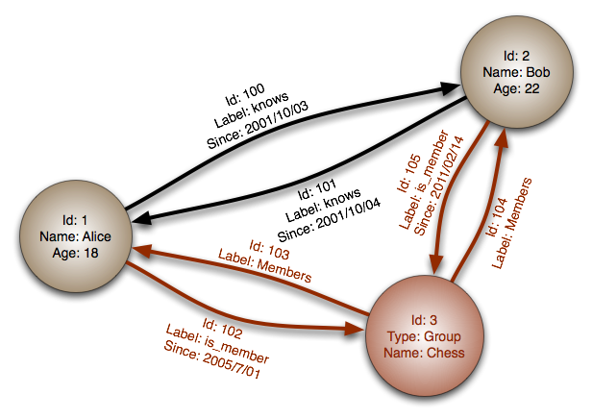
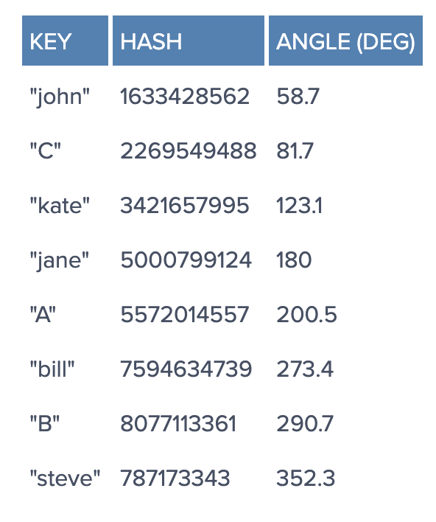
NOSQL DATABASE MODELS
DOCUMENT
(JSON, XML, BLOB, ETC...)
GRAPH
RELATIONAL NODES
KEY-VALUE HASH
KEYS ARE MAPPED TO VALUES (STRINGS, JSONS, BLOB, ETC...)

Slide 12
THE NOSQL ECOSYSTEM
Popular NoSQL DBMS Platforms
MongoDB, DynamoDB, Redis, Cassandra, Firebase.
No Universal Standard
Each engine relies on its own custom query API or syntax.
Schema-less flexibility allows data structures to evolve without rigid migrations.

Slide 13
WHAT ARE DATABASE QUERIES?
Definition
A formal request sent to a database system to retrieve or manipulate specific data.
Complexity
As databases grow and relationships multiply, queries require higher structural logic.
Real-world Analogy
Running a Google search or applying filters on an online banking dashboard are examples of queries.

Slide 14
WRAP UP 🎁
Database
Any organized collection of related information.
DBMS
Software that creates, manages, and secures databases.
CRUD
Create, Read, Update, Delete operations.
Relational (SQL)
Organizes data into tables with primary/foreign key relationships.
Non-Relational (NoSQL)
Stores data using alternative structures (Documents, Key-Value, Graphs).
Queries
Instructions used to retrieve and manipulate stored data.

